Slide 1
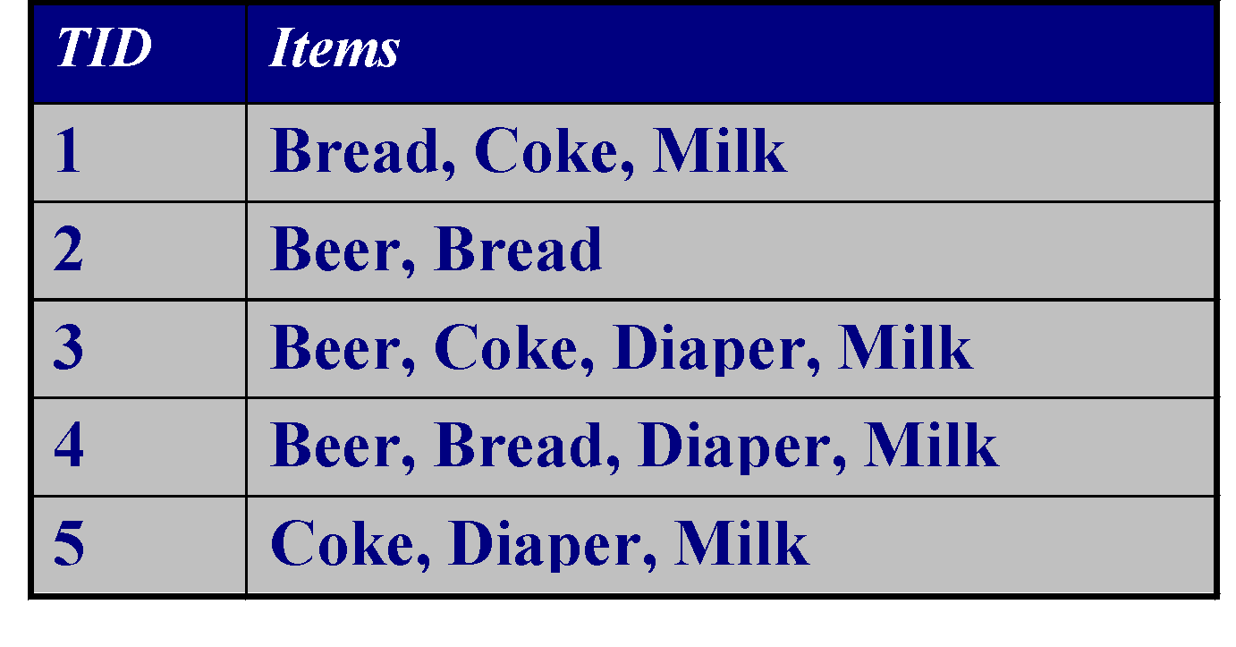
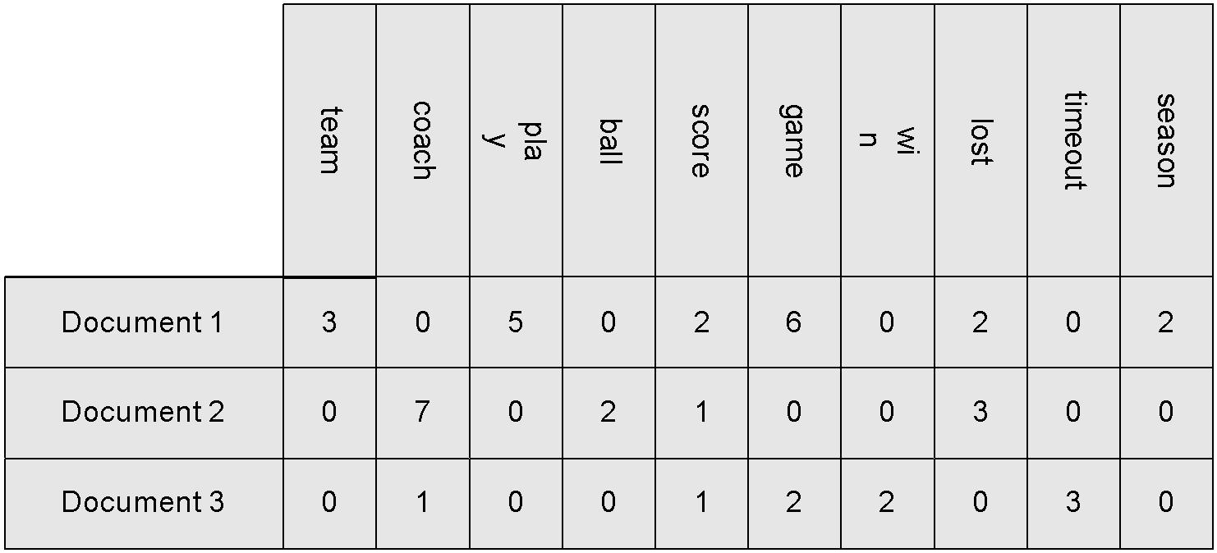
Types of Data Sets
Record
Relational records
Data matrix, e.g., numerical matrix, crosstabs
Document data: text documents: term-frequency vector
Transaction data
Graph and network
World Wide Web
Social or information networks
Molecular Structures
Ordered
Video data: sequence of images
Temporal data: time-series
Sequential Data: transaction sequences
Genetic sequence data
Spatial, image and multimedia:
Spatial data: maps
Image data:
Video data:
‹#›
Notes:
‹#›

Slide 2
Important Characteristics of Structured Data
Dimensionality
Curse of dimensionality
Sparsity
Only presence counts
Resolution
Patterns depend on the scale
Distribution
Centrality and dispersion
‹#›
Notes:
‹#›

Slide 3
Data Objects
Data sets are made up of data objects.
A data object represents an entity.
Examples:
sales database: customers, store items, sales
medical database: patients, treatments
university database: students, professors, courses
Also called samples , examples, instances, data points, objects, tuples.
Data objects are described by attributes.
Database rows -> data objects; columns ->attributes.
‹#›
Notes:
‹#›

Slide 4
Attributes
Attribute (or dimensions, features, variables): a data field, representing a characteristic or feature of a data object.
E.g., customer _ID, name, address
Types:
Nominal
Binary
Numeric: quantitative
Interval-scaled
Ratio-scaled
‹#›
Notes:
‹#›

Slide 5
Attribute Types
Nominal: categories, states, or “names of things”
Hair_color = {auburn, black, blond, brown, grey, red, white}
marital status, occupation, ID numbers, zip codes
Binary
Nominal attribute with only 2 states (0 and 1)
Symmetric binary: both outcomes equally important
e.g., gender
Asymmetric binary: outcomes not equally important.
e.g., medical test (positive vs. negative)
Convention: assign 1 to most important outcome (e.g., HIV positive)
Ordinal
Values have a meaningful order (ranking) but magnitude between successive values is not known.
Size = {small, medium, large}, grades, army rankings
‹#›
Notes:
‹#›

Slide 6
Numeric Attribute Types
Quantity (integer or real-valued)
Interval
Measured on a scale of equal-sized units
Values have order
E.g., temperature in C˚or F˚, calendar dates
No true zero-point
Ratio
Inherent zero-point
We can speak of values as being an order of magnitude larger than the unit of measurement (10 K˚ is twice as high as 5 K˚).
e.g., temperature in Kelvin, length, counts, monetary quantities
‹#›
Notes:
‹#›

Slide 7
Discrete vs. Continuous Attributes
Discrete Attribute
Has only a finite or countably infinite set of values
E.g., zip codes, profession, or the set of words in a collection of documents
Sometimes, represented as integer variables
Note: Binary attributes are a special case of discrete attributes
Continuous Attribute
Has real numbers as attribute values
E.g., temperature, height, or weight
Practically, real values can only be measured and represented using a finite number of digits
Continuous attributes are typically represented as floating-point variables
‹#›
Notes:
‹#›

Slide 8
Basic Statistical Descriptions of Data
Motivation
To better understand the data:
Measures of central tendency -
mean,median,mode,midrange
Measuring the Data dispersion -
range,quartiles,interquartile range,five-number summary,boxplots,outliersmedian
Graphic displays -
quantile plot, quantile-quantile plot,histogram,scatter plot
‹#›
Notes:
‹#›

Slide 9
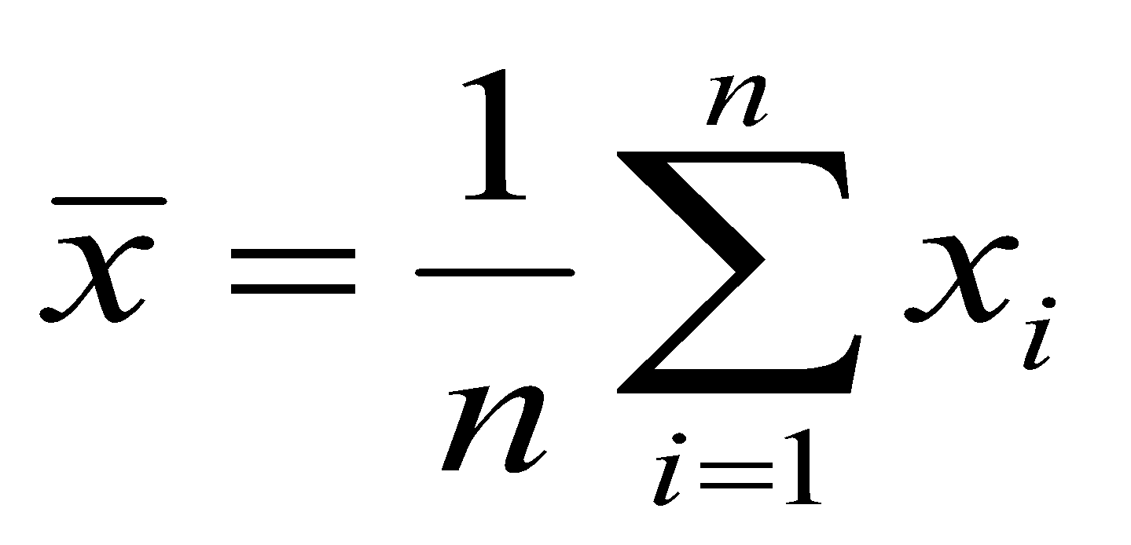
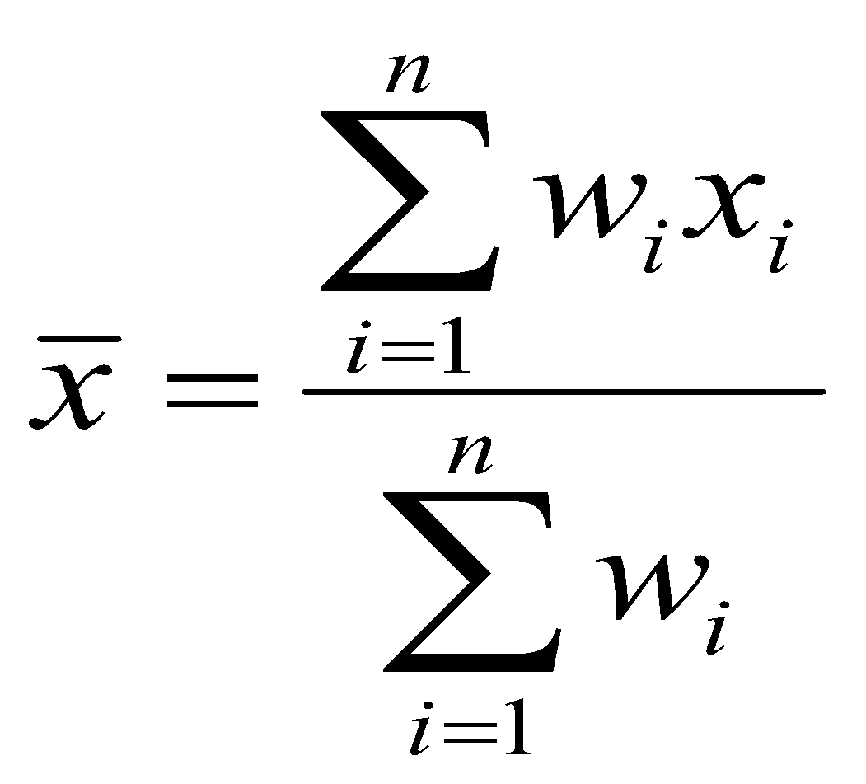
Measuring the Central Tendency
Mean :
Note: n is sample size
Weighted arithmetic mean:
Trimmed mean: chopping extreme values
‹#›
Notes:
‹#›

Slide 10
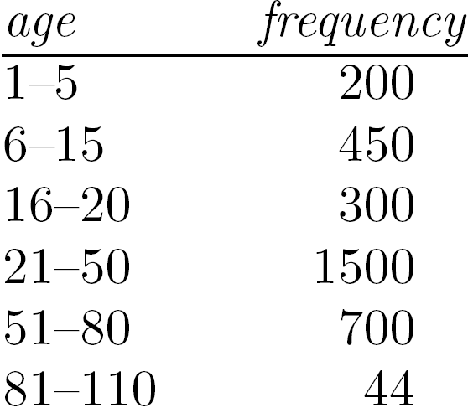
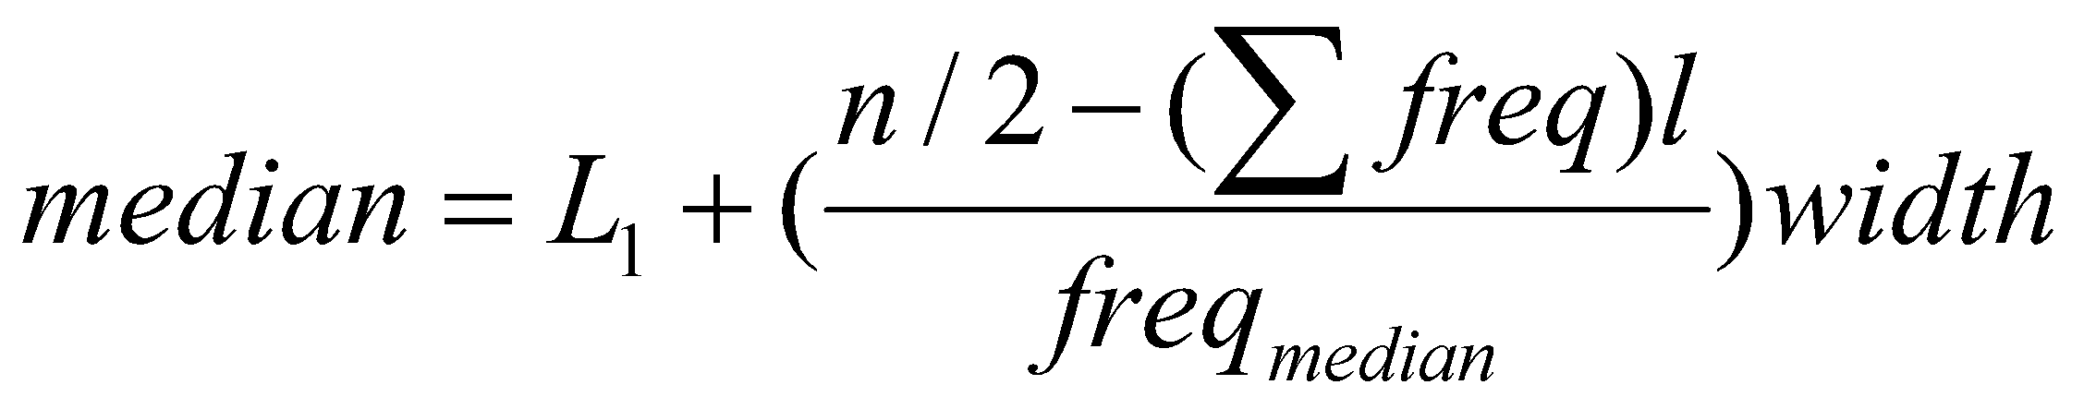
Measuring the Central Tendency
Median:
Middle value if odd number of values, or average of the middle two values otherwise
Estimated by interpolation (for grouped data):
‹#›
Notes:
‹#›

Slide 11
Measuring the Central Tendency
Mode
Value that occurs most frequently in the data
Unimodal, bimodal, trimodal
Empirical formula:
‹#›
Notes:
‹#›

Slide 12
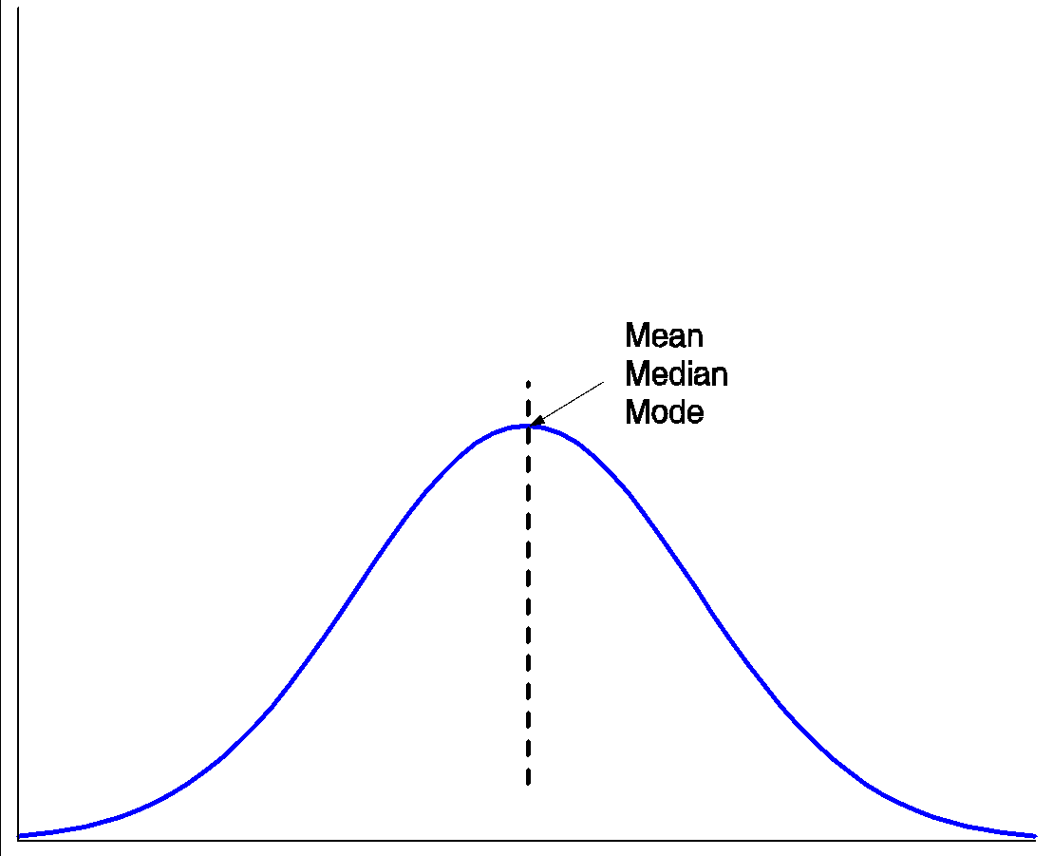
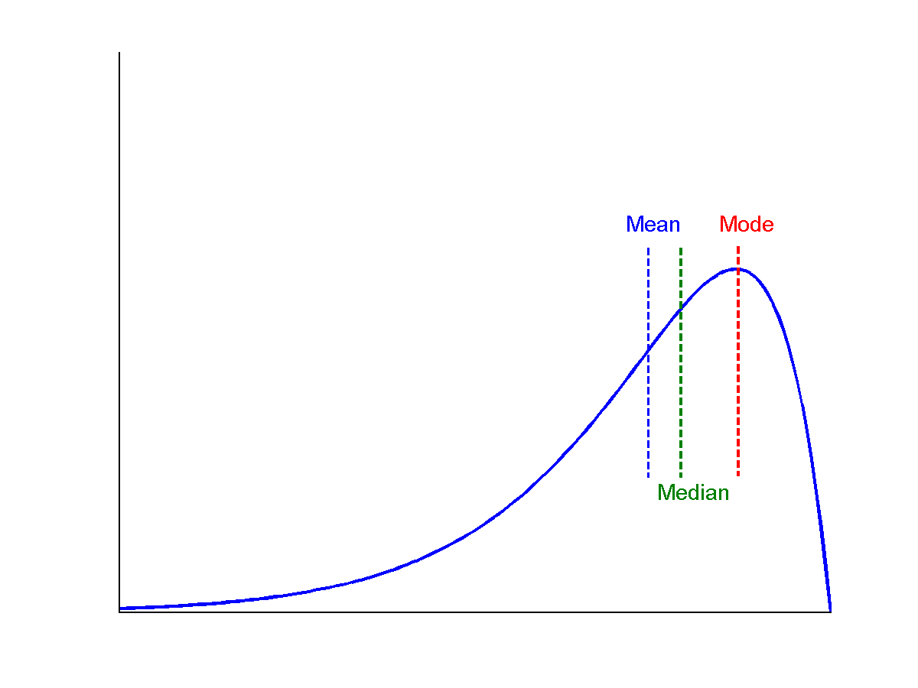
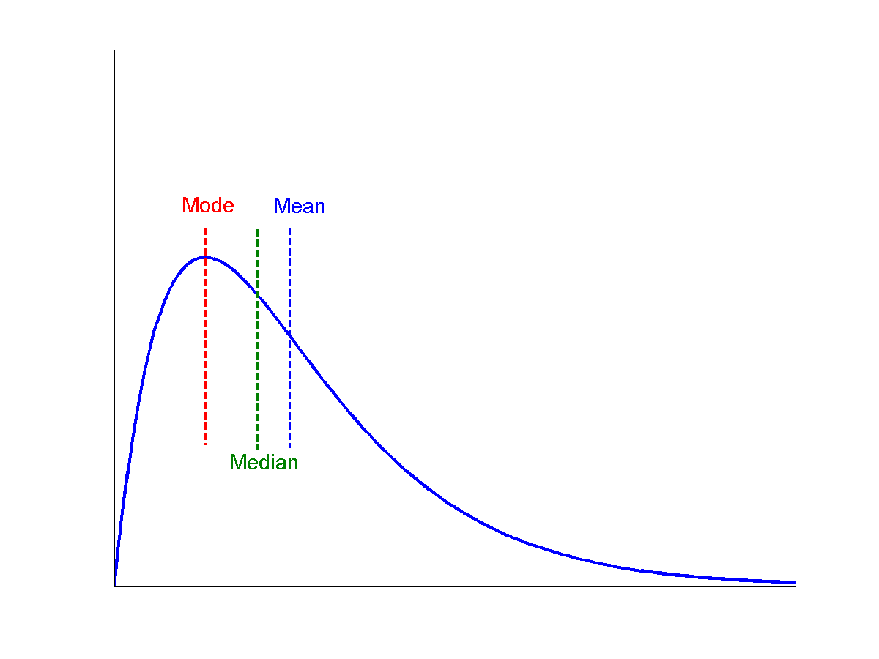
Symmetric vs. Skewed Data
Median, mean and mode of symmetric, positively and negatively skewed data
symmetric
positively skewed
negatively skewed
*
Data Mining: Concepts and Techniques
‹#›
Notes:
‹#›

Slide 13
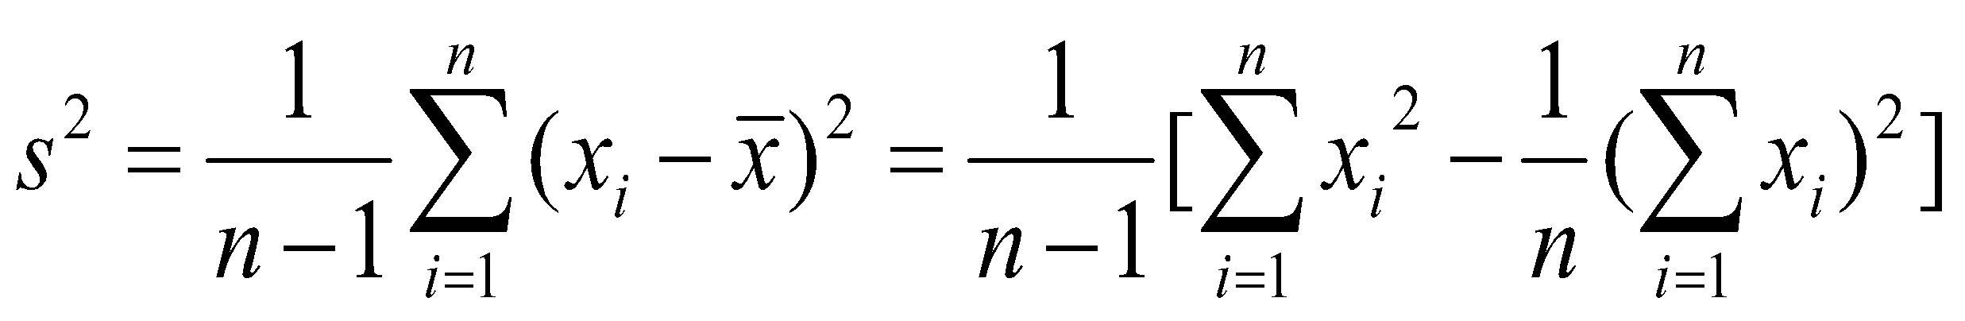
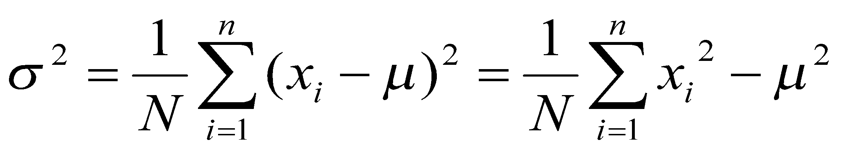
Measuring the Dispersion of Data
Quartiles, outliers and boxplots
Quartiles: Q₁ (25th percentile), Q₃ (75th percentile)
Inter-quartile range: IQR = Q₃ – Q₁
Five number summary: min, Q₁, median, Q₃, max
Boxplot: ends of the box are the quartiles; median is marked; add whiskers, and plot outliers individually
Outlier: usually, a value higher/lower than 1.5 x IQR
Variance and standard deviation (sample: s, population: σ)
Variance: (algebraic, scalable computation)
Standard deviation s (or σ) is the square root of variance s² ⁽or σ²⁾
‹#›
Notes:
‹#›

Slide 14
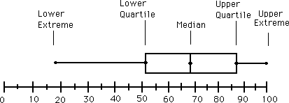
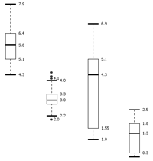
Boxplot Analysis
Five-number summary of a distribution
Minimum, Q1, Median, Q3, Maximum
Boxplot
Data is represented with a box
The ends of the box are at the first and third quartiles, i.e., the height of the box is IQR
The median is marked by a line within the box
Whiskers: two lines outside the box extended to Minimum and Maximum
Outliers: points beyond a specified outlier threshold (1.5*IQR) , plotted individually
‹#›
Notes:
‹#›

Slide 15
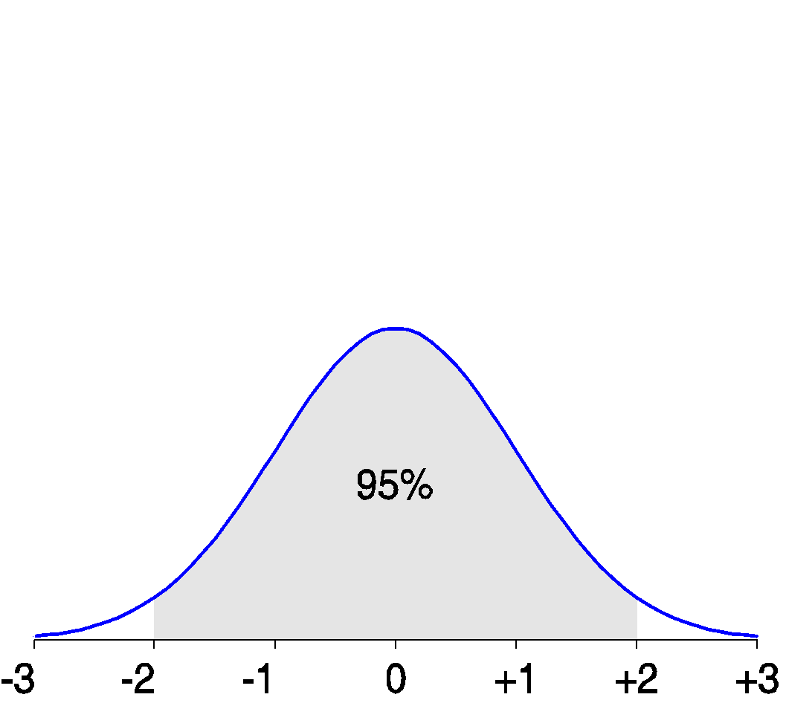
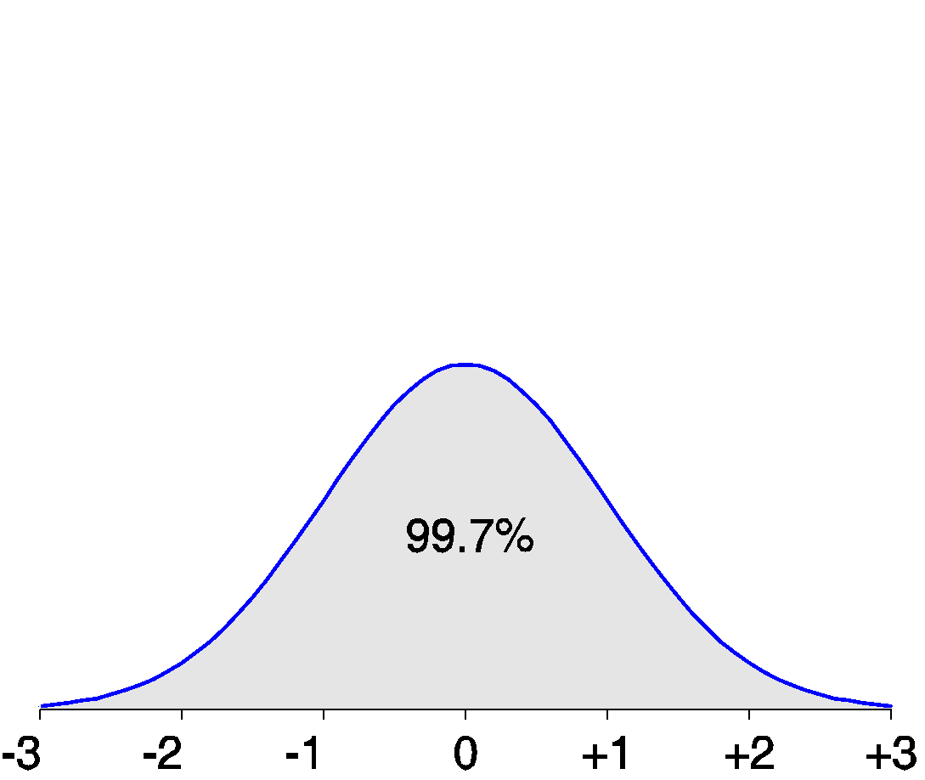
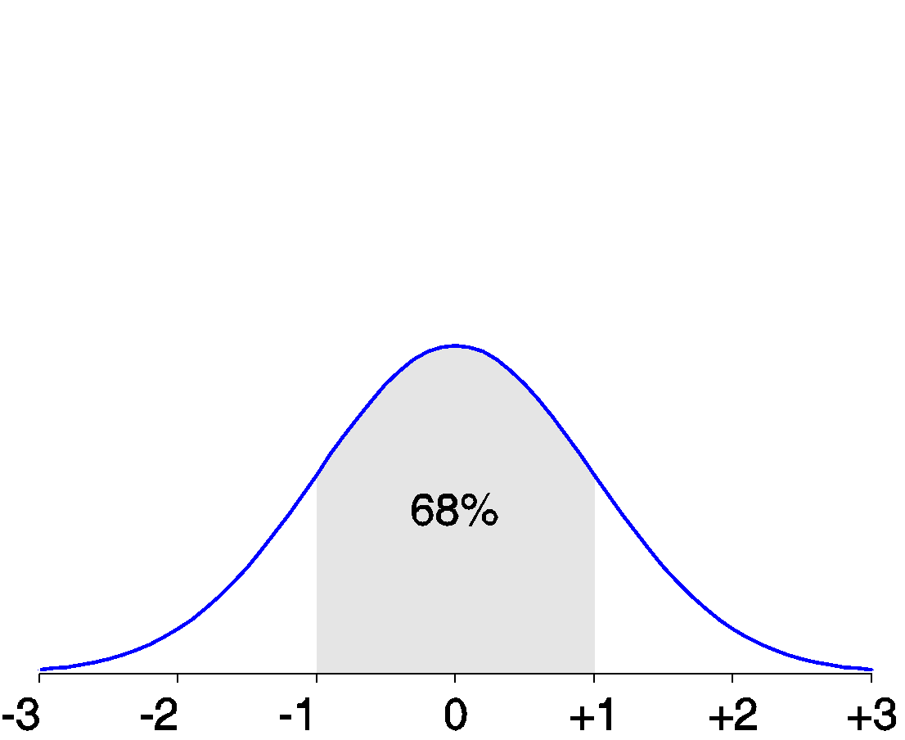
Properties of Normal Distribution Curve
The normal (distribution) curve
From μ–σ to μ+σ: contains about 68% of the measurements (μ: mean, σ: standard deviation)
From μ–2σ to μ+2σ: contains about 95% of it
From μ–3σ to μ+3σ: contains about 99.7% of it
‹#›
Notes:
‹#›

Slide 16
Graphic Displays of Basic Statistical Descriptions
Boxplot: graphic display of five-number summary
Histogram: x-axis are values, y-axis repres. frequencies
Quantile plot: each value x_{i} is paired with f_{i} indicating that approximately 100 f_{i} % of data are ≤ x_{i}
Quantile-quantile (q-q) plot: graphs the quantiles of one univariant distribution against the corresponding quantiles of another
Scatter plot: each pair of values is a pair of coordinates and plotted as points in the plane
‹#›
Notes:
‹#›

Slide 17
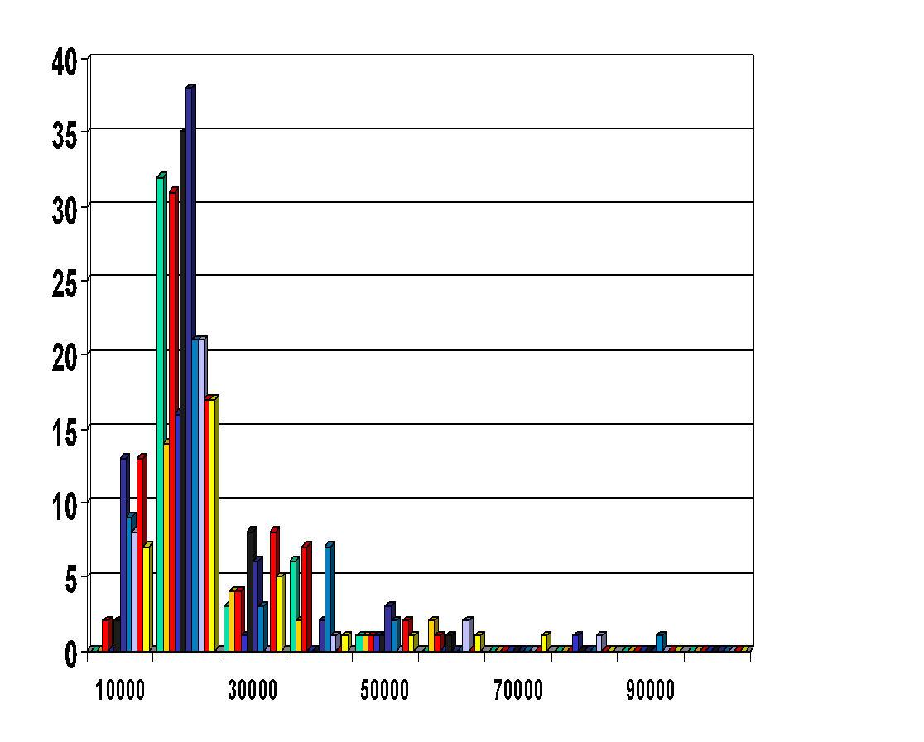
Histogram Analysis
Histogram: Graph display of tabulated frequencies, shown as bars
It shows what proportion of cases fall into each of several categories
Differs from a bar chart in that it is the area of the bar that denotes the value, not the height as in bar charts, a crucial distinction when the categories are not of uniform width
The categories are usually specified as non-overlapping intervals of some variable. The categories (bars) must be adjacent
‹#›
Notes:
‹#›

Slide 18
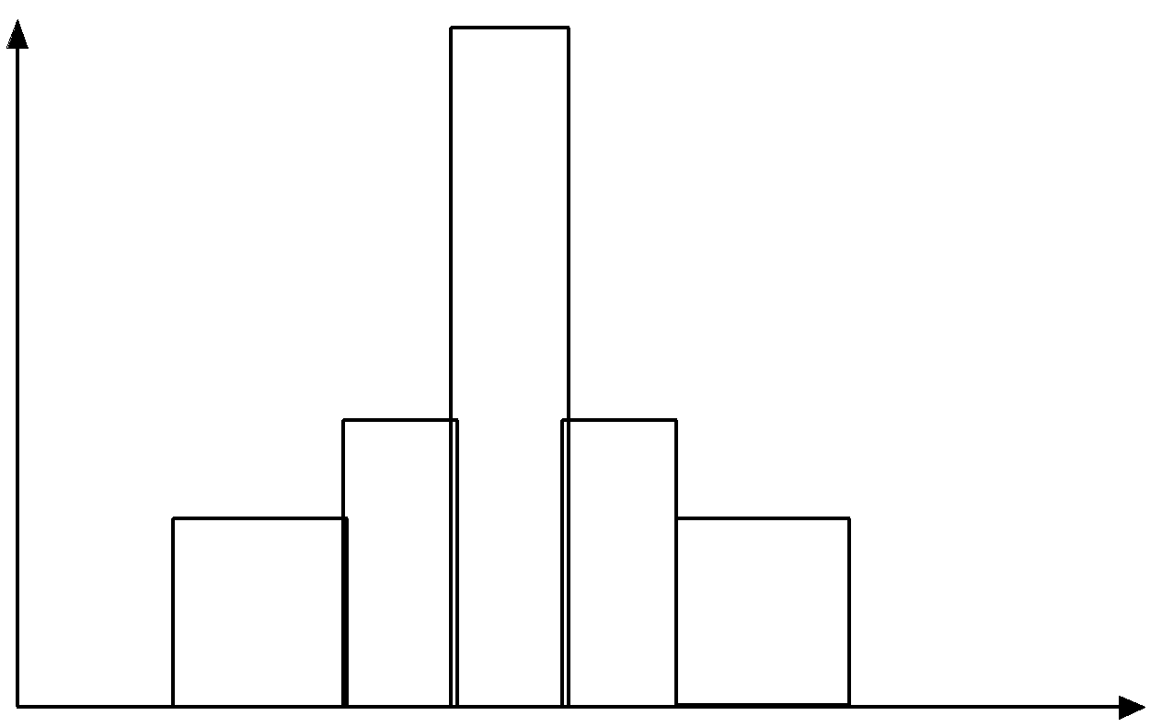
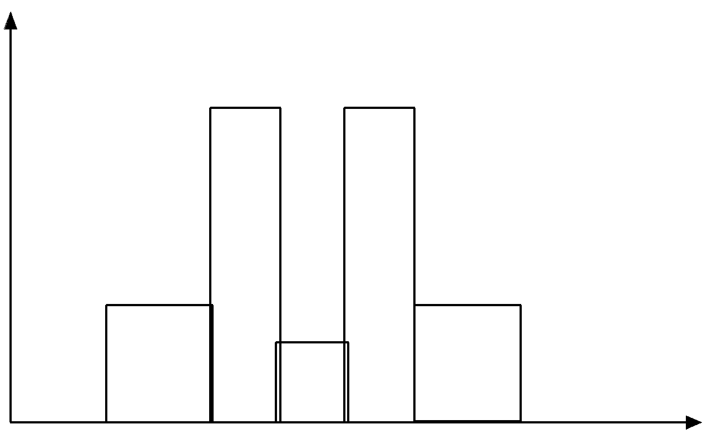
Histograms Often Tell More than Boxplots
The two histograms shown in the left may have the same boxplot representation
The same values for: min, Q1, median, Q3, max
But they have rather different data distributions
‹#›
Notes:
‹#›

Slide 19
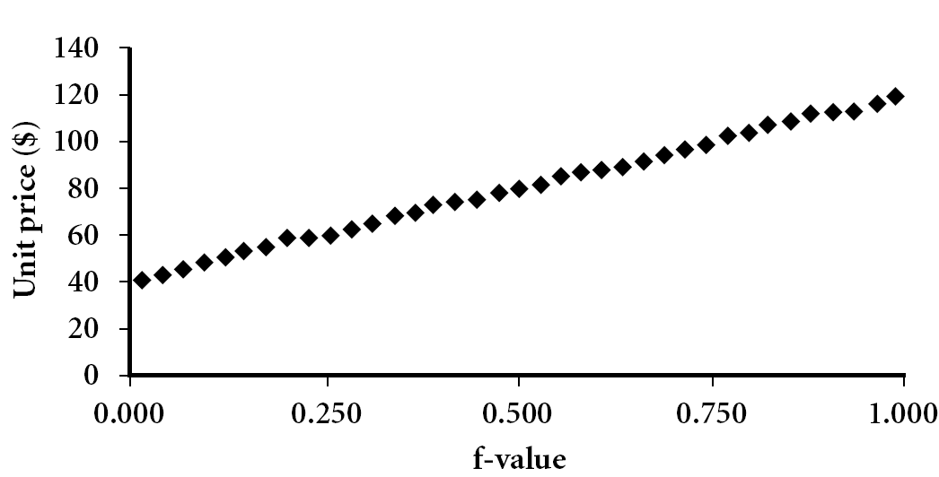
Quantile Plot
Displays all of the data (allowing the user to assess both the overall behavior and unusual occurrences)
Plots quantile information
For a data x_{i} data sorted in increasing order, f_{i} indicates that approximately 100 f_{i}% of the data are below or equal to the value x_{i}
Data Mining: Concepts and Techniques
‹#›
Notes:
‹#›

Slide 20
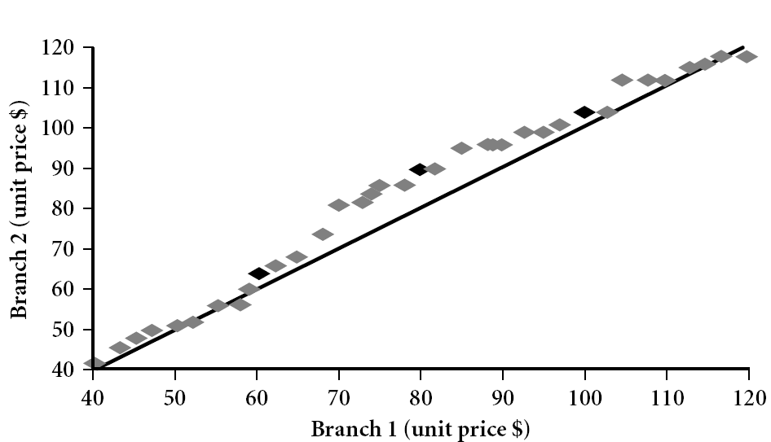
Quantile-Quantile (q-q) Plot
Graphs the quantiles of one univariate distribution against the corresponding quantiles of another
View: Is there is a shift in going from one distribution to another?
Example shows unit price of items sold at Branch 1 vs. Branch 2 for each quantile. Unit prices of items sold at Branch 1 tend to be lower than those at Branch 2.
‹#›
Notes:
‹#›
Note: We need to label the dark plotted points as Q1, Median, Q3 – that would help in understanding this graph.
Tell audience: There is a shift in distribution of branch 1 WRT branch 2 in that the unit prices of items sold at branch 1 tend to be lower than those at branch 2.

Slide 21
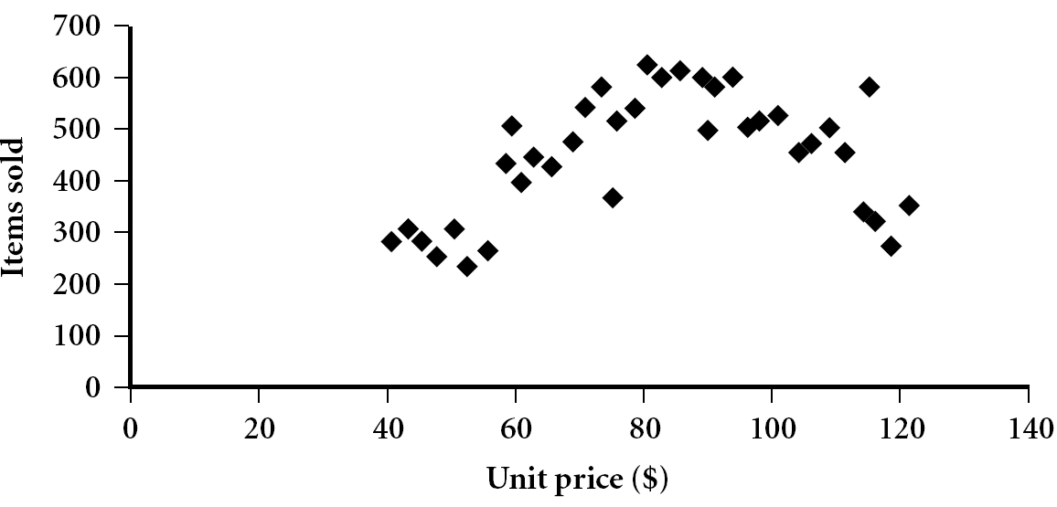
Scatter plot
Provides a first look at bivariate data to see clusters of points, outliers, etc
Each pair of values is treated as a pair of coordinates and plotted as points in the plane
‹#›
Notes:
‹#›

Slide 22
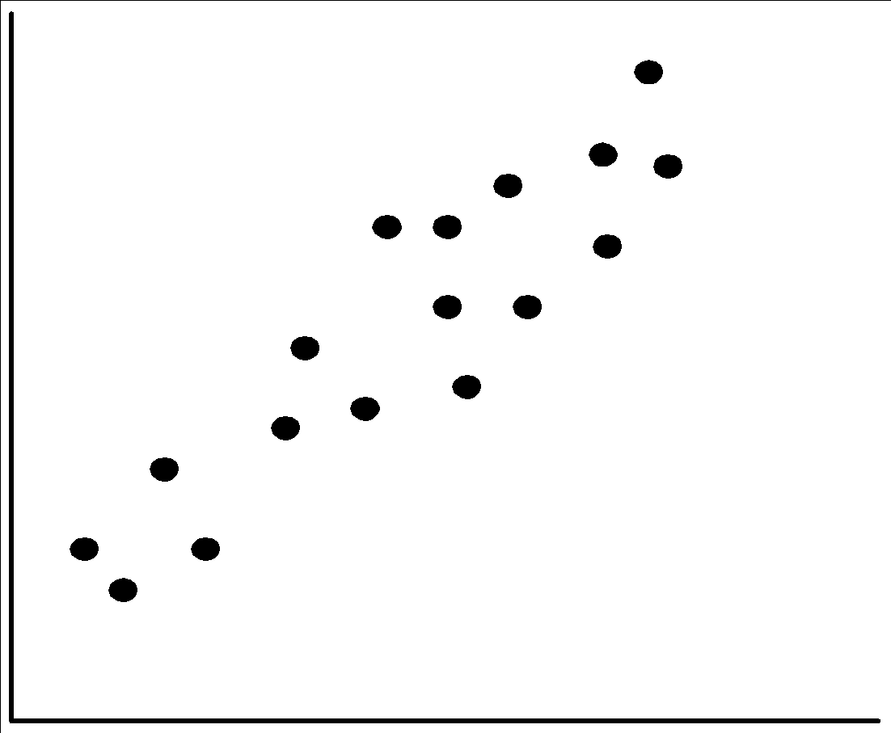
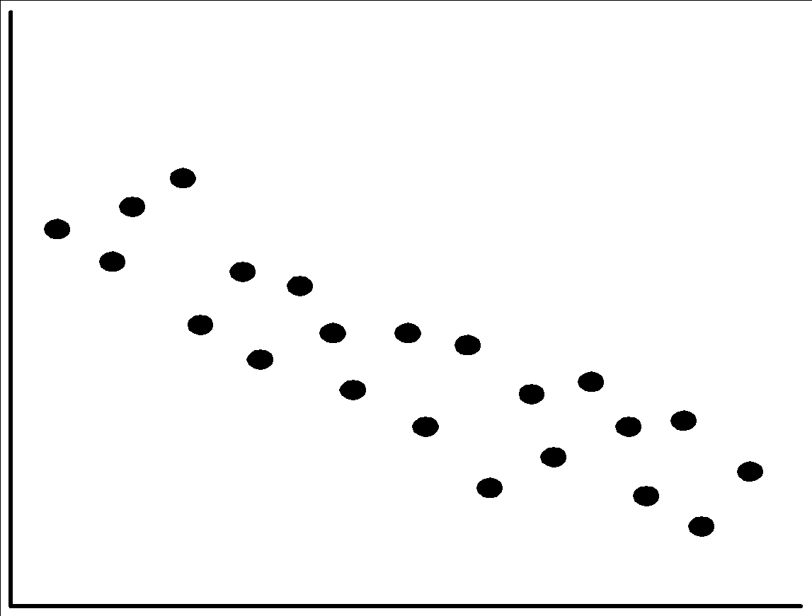
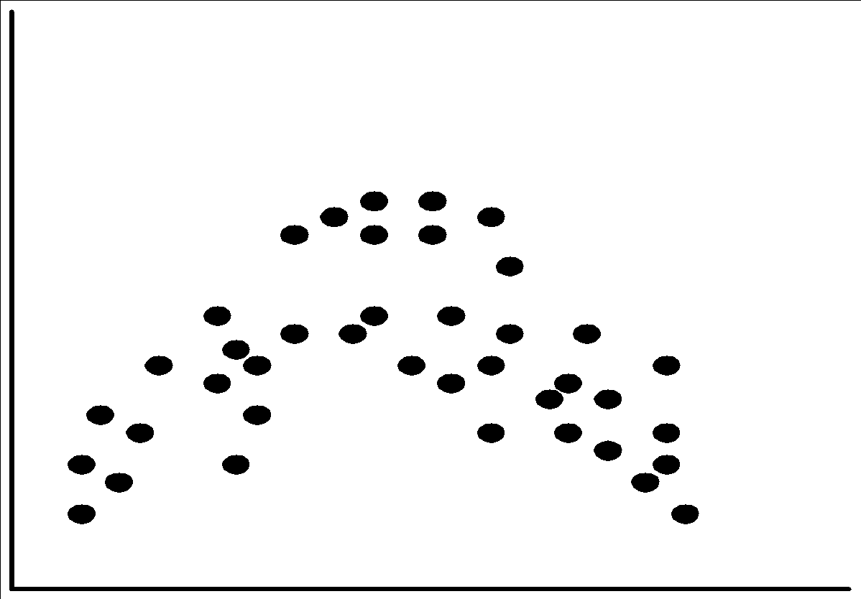
Positively and Negatively Correlated Data
The left half fragment is positively correlated
The right half is negative correlated
‹#›
Notes:
‹#›

Slide 23
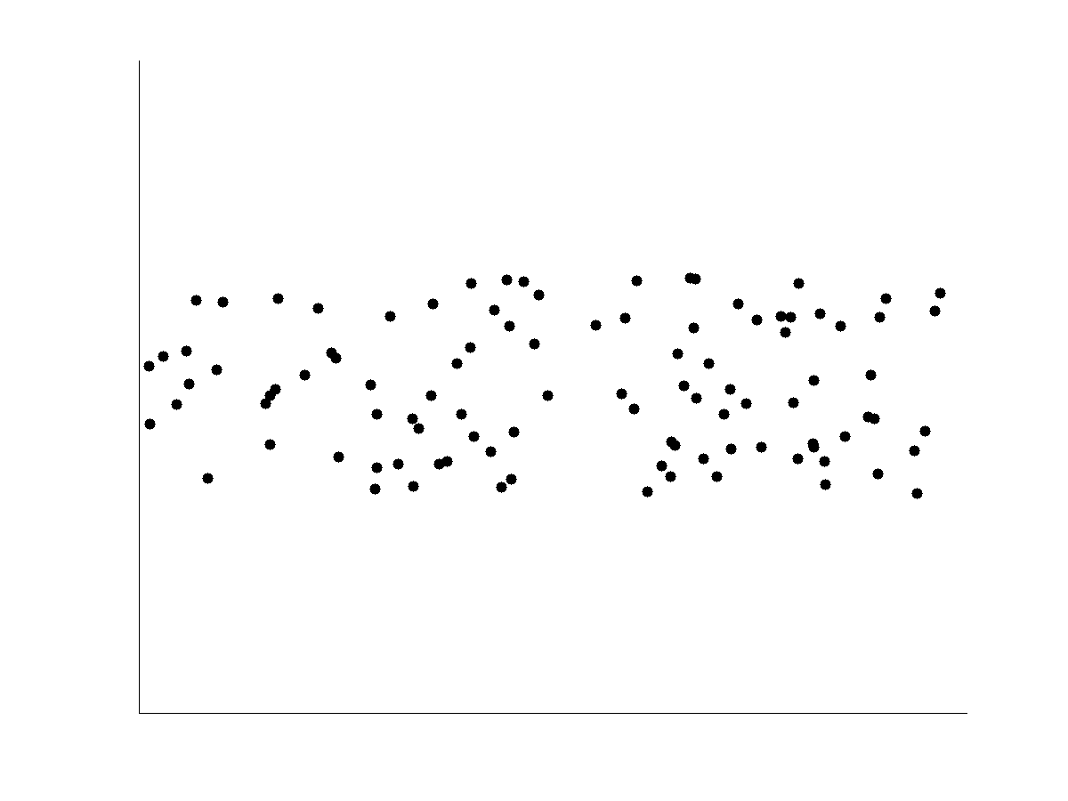
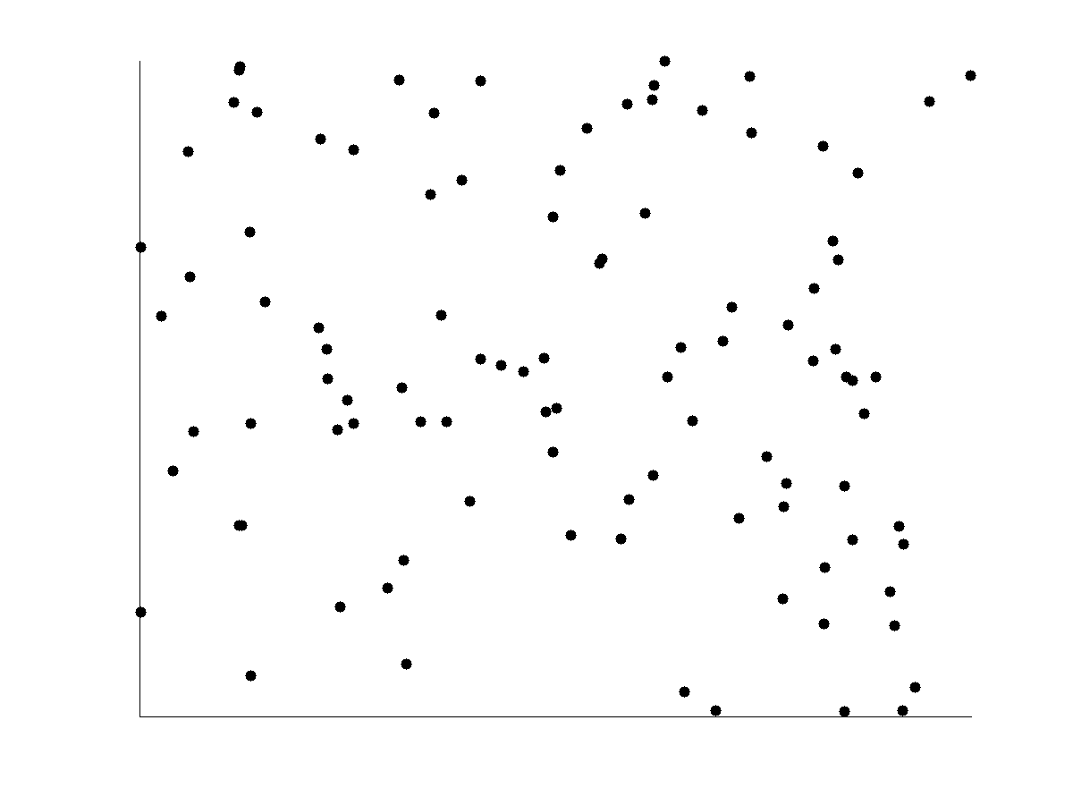
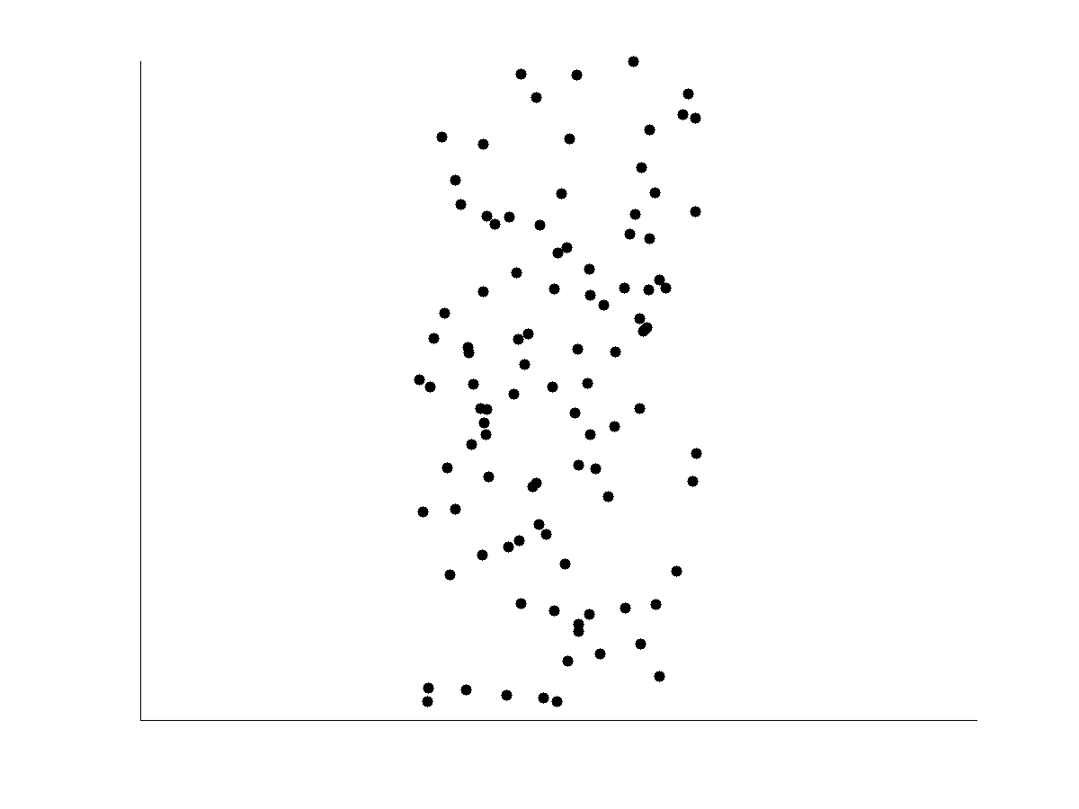
Uncorrelated Data
‹#›
Notes:
‹#›

Slide 24
Data Visualization
Why data visualization?
Gain insight into an information space by mapping data onto graphical primitives
Provide qualitative overview of large data sets
Search for patterns, trends, structure, irregularities, relationships among data
Help find interesting regions and suitable parameters for further quantitative analysis
Provide a visual proof of computer representations derived
Categorization of visualization methods:
Pixel-oriented visualization techniques
Geometric projection visualization techniques
Icon-based visualization techniques
Hierarchical visualization techniques
Visualizing complex data and relations
‹#›
Notes:
‹#›

Slide 25
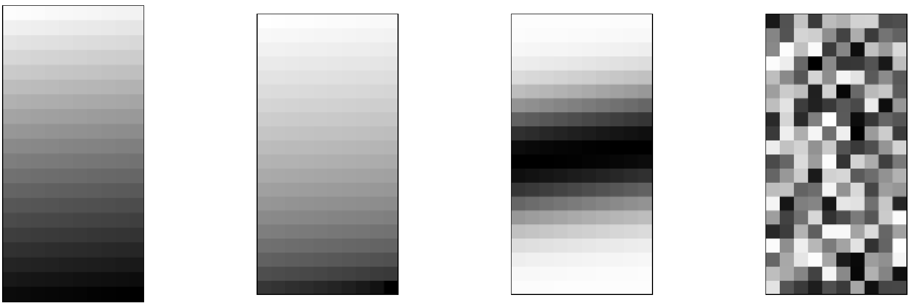
Pixel-Oriented Visualization Techniques
For a data set of m dimensions, create m windows on the screen, one for each dimension
The m dimension values of a record are mapped to m pixels at the corresponding positions in the windows
The colors of the pixels reflect the corresponding values
Income
(b) Credit Limit
(c) transaction volume
(d) age
‹#›
Notes:
‹#›

Slide 26
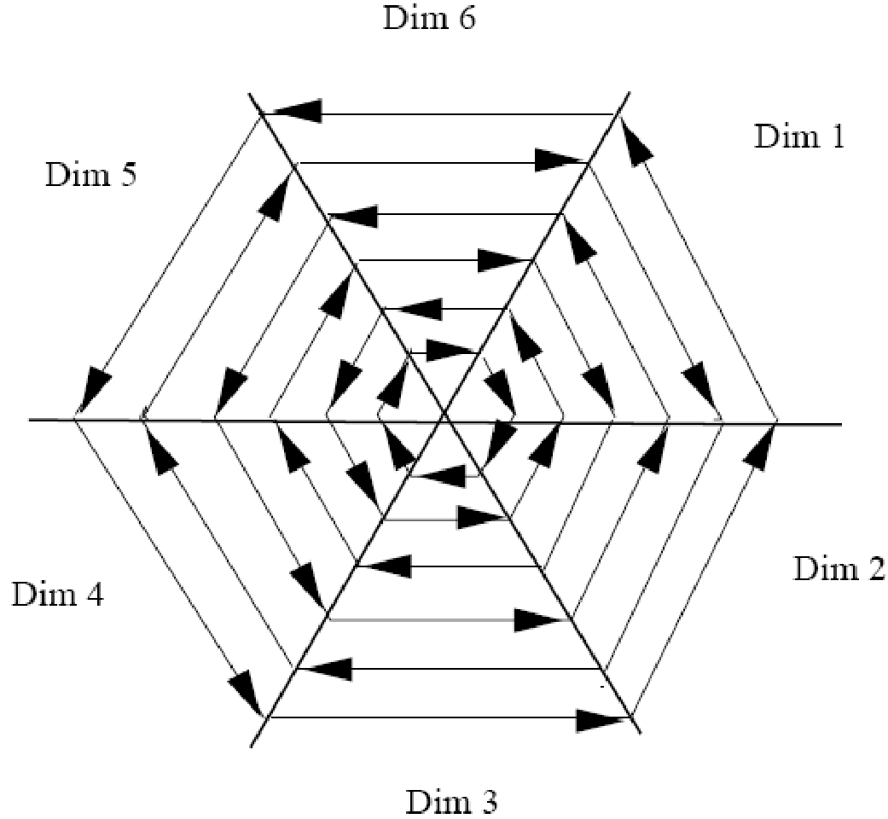
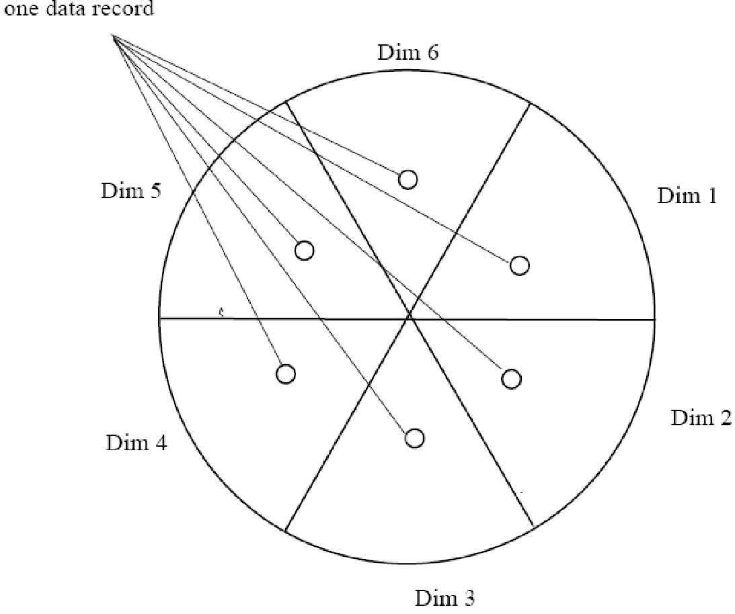
Laying Out Pixels in Circle Segments
To save space and show the connections among multiple dimensions, space filling is often done in a circle segment
Representing a data record in circle segment
(b) Laying out pixels in circle segment
‹#›
Notes:
‹#›

Slide 27
Geometric Projection Visualization Techniques
Visualization of geometric transformations and projections of the data
Methods
Direct visualization
Scatterplot and scatterplot matrices
Landscapes
Projection pursuit technique: Help users find meaningful projections of multidimensional data
Prosection views
Hyperslice
Parallel coordinates
‹#›
Notes:
‹#›

Slide 28
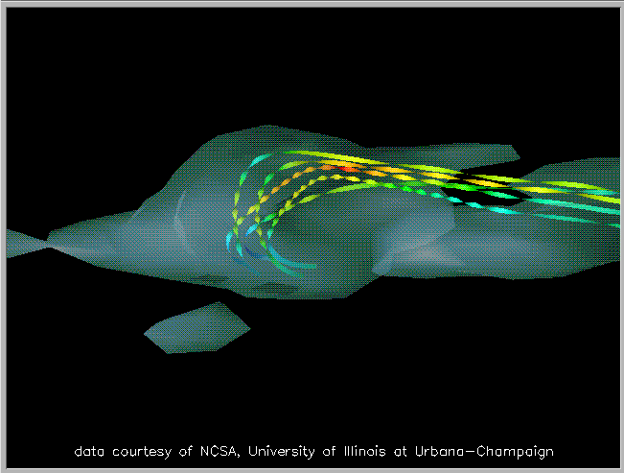
Direct Data Visualization
Ribbons with Twists Based on Vorticity
Data Mining: Concepts and Techniques
‹#›
Notes:
‹#›
http://books.elsevier.com/companions/1558606890/pictures/Chapter_01/fig1-6b.gif

Slide 29
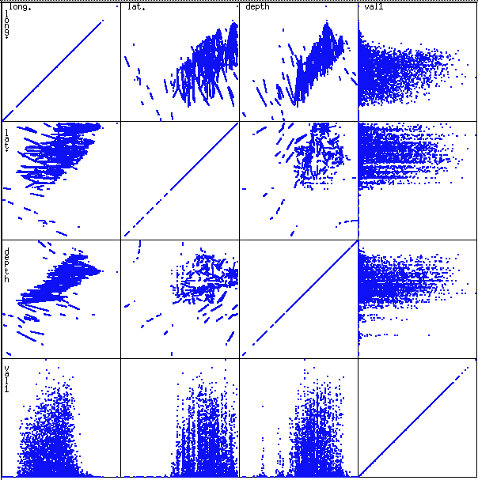
Scatterplot Matrices
Used by ermission of M. Ward, Worcester Polytechnic Institute
Matrix of scatterplots (x-y-diagrams) of the k-dim. data [total of (k2/2-k) scatterplots]
‹#›
Notes:
‹#›

Slide 30
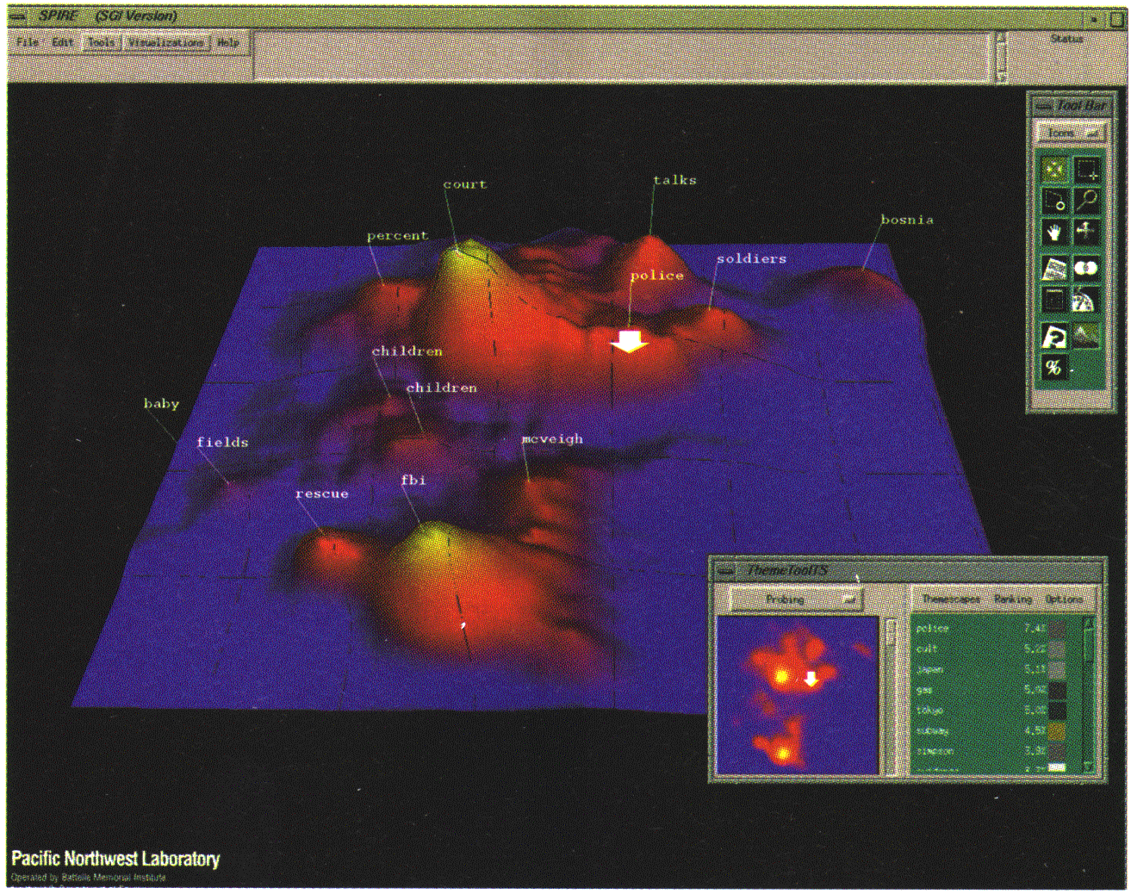
Landscapes
news articles visualized as a landscape
Used by permission of B. Wright, Visible Decisions Inc.
Visualization of the data as perspective landscape
The data needs to be transformed into a (possibly artificial) 2D spatial representation which preserves the characteristics of the data
‹#›
Notes:
‹#›

Slide 31
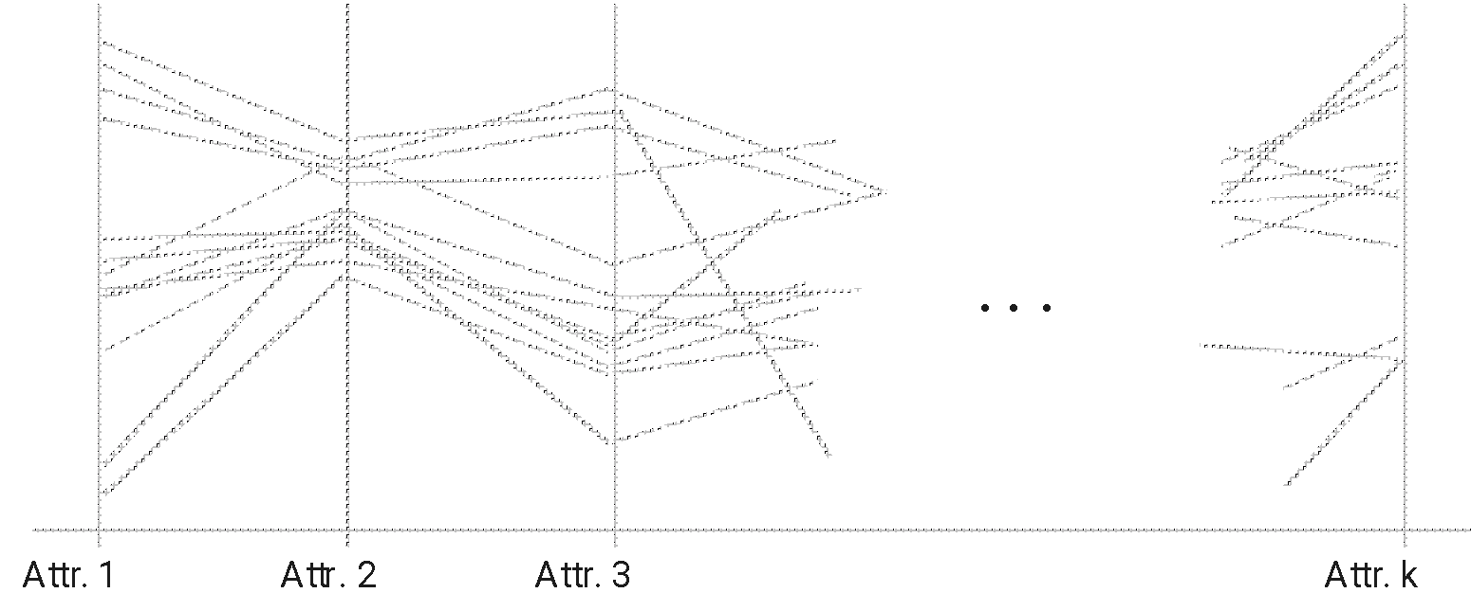
Parallel Coordinates
n equidistant axes which are parallel to one of the screen axes and correspond to the attributes
The axes are scaled to the [minimum, maximum]: range of the corresponding attribute
Every data item corresponds to a polygonal line which intersects each of the axes at the point which corresponds to the value for the attribute
‹#›
Notes:
‹#›

Slide 32
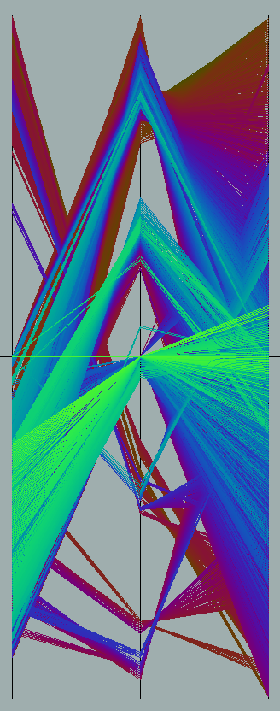
Parallel Coordinates of a Data Set
‹#›
Notes:
‹#›

Slide 33
Icon-Based Visualization Techniques
Visualization of the data values as features of icons
Typical visualization methods
Chernoff Faces
Stick Figures
General techniques
Shape coding: Use shape to represent certain information encoding
Color icons: Use color icons to encode more information
Tile bars: Use small icons to represent the relevant feature vectors in document retrieval
‹#›
Notes:
‹#›

Slide 34
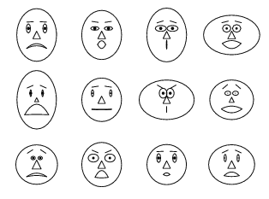
Chernoff Faces
A way to display variables on a two-dimensional surface, e.g., let x be eyebrow slant, y be eye size, z be nose length, etc.
The figure shows faces produced using 10 characteristics--head eccentricity, eye size, eye spacing, eye eccentricity, pupil size, eyebrow slant, nose size, mouth shape, mouth size, and mouth opening): Each assigned one of 10 possible values, generated using Mathematica (S. Dickson)
REFERENCE: Gonick, L. and Smith, W. The Cartoon Guide to Statistics. New York: Harper Perennial, p. 212, 1993
Weisstein, Eric W. "Chernoff Face." From MathWorld--A Wolfram Web Resource. mathworld.wolfram.com/ChernoffFace.html
‹#›
Notes:
‹#›

Slide 35
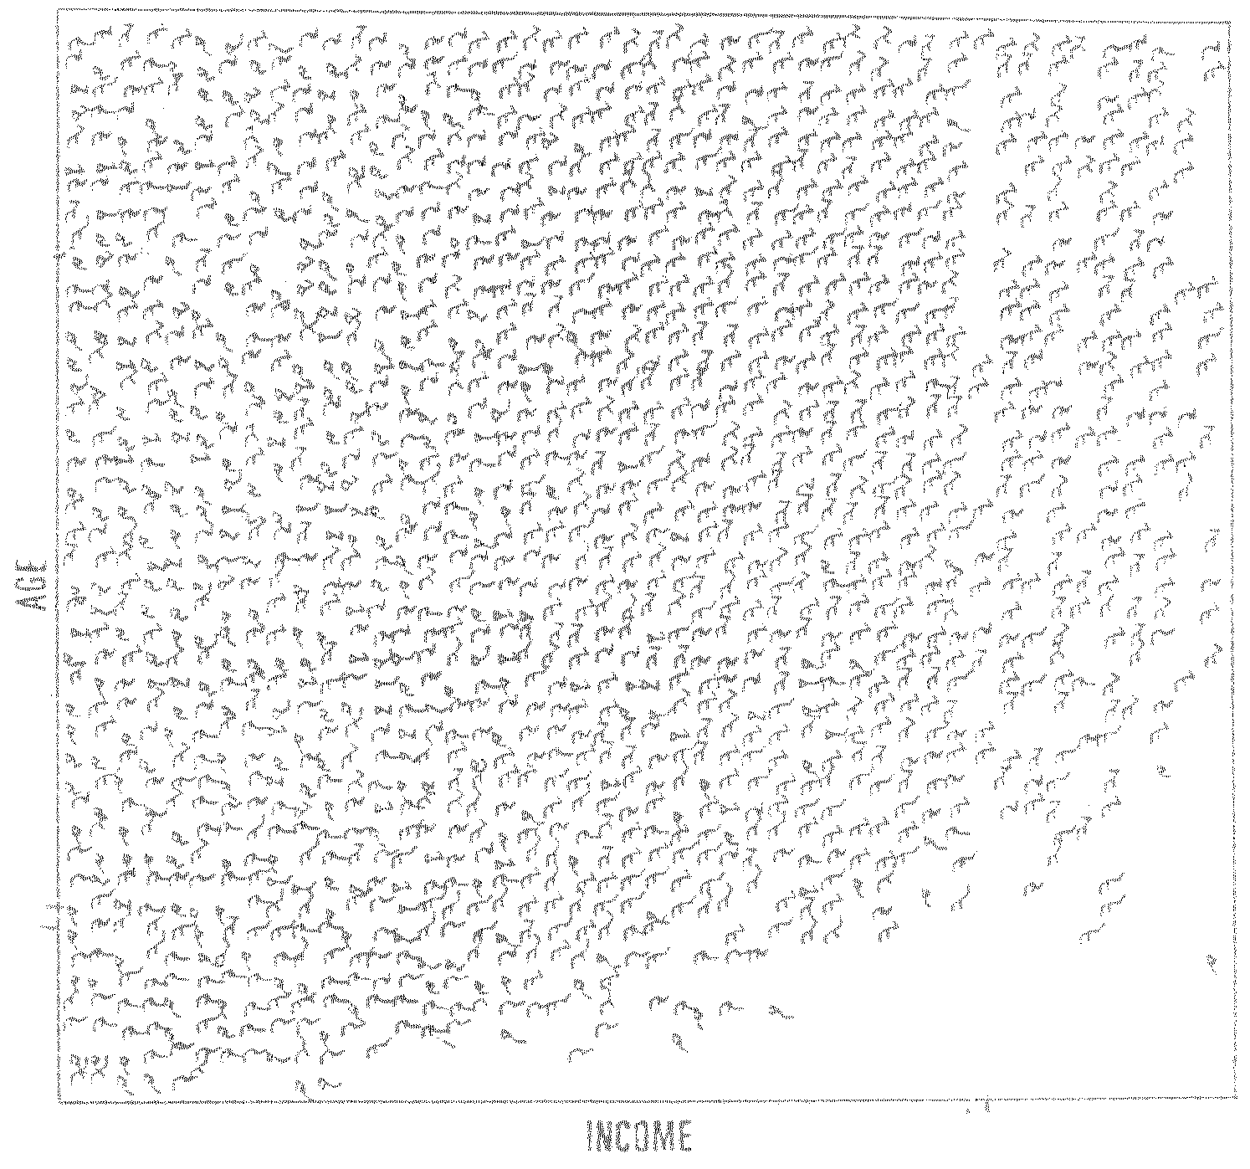
Stick Figure
A census data figure showing age, income, gender, education, etc.
used by permission of G. Grinstein, University of Massachusettes at Lowell
A 5-piece stick figure (1 body and 4 limbs w. different angle/length)
Two attributes mapped to axes, remaining attributes mapped to angle or length of limbs”. Look at texture pattern
‹#›
Notes:
‹#›

Slide 36
Hierarchical Visualization Techniques
Visualization of the data using a hierarchical partitioning into subspaces
Methods
Dimensional Stacking
Worlds-within-Worlds
Tree-Map
Cone Trees
InfoCube
‹#›
Notes:
‹#›

Slide 37
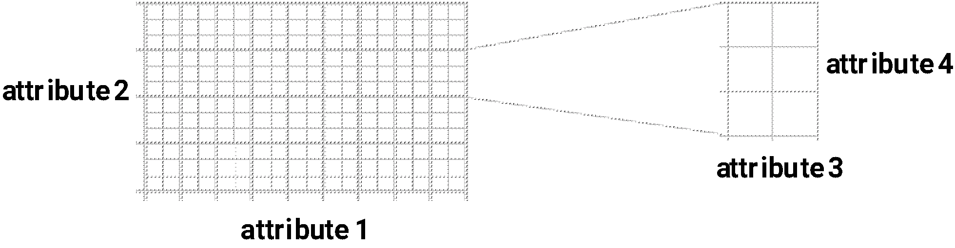
Dimensional Stacking
Partitioning of the n-dimensional attribute space in 2-D subspaces, which are ‘stacked’ into each other
Partitioning of the attribute value ranges into classes. The important attributes should be used on the outer levels.
Adequate for data with ordinal attributes of low cardinality
But, difficult to display more than nine dimensions
Important to map dimensions appropriately
‹#›
Notes:
‹#›

Slide 38
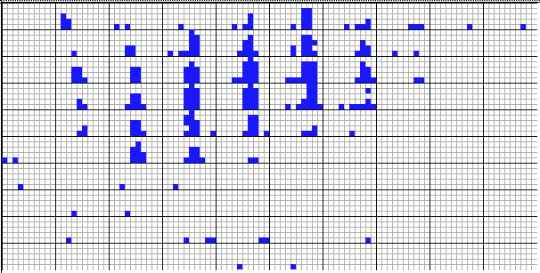
Dimensional Stacking
Used by permission of M. Ward, Worcester Polytechnic Institute
Visualization of oil mining data with longitude and latitude mapped to the outer x-, y-axes and ore grade and depth mapped to the inner x-, y-axes
‹#›
Notes:
‹#›

Slide 39
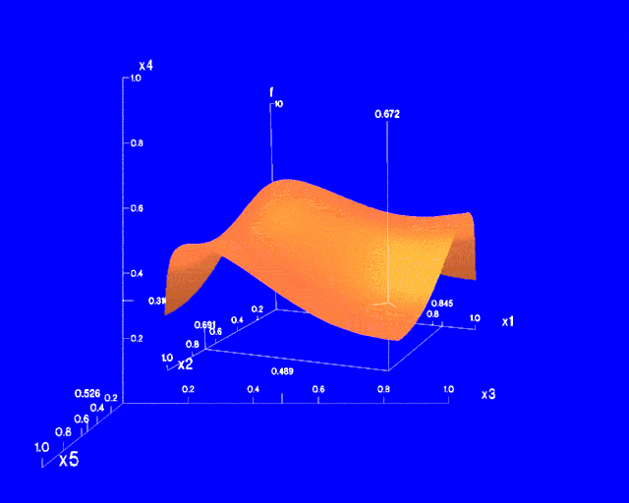
Worlds-within-Worlds
Assign the function and two most important parameters to innermost world
Fix all other parameters at constant values - draw other (1 or 2 or 3 dimensional worlds choosing these as the axes)
Software that uses this paradigm
N–vision: Dynamic interaction through data glove and stereo displays, including rotation, scaling (inner) and translation (inner/outer)
Auto Visual: Static interaction by means of queries
‹#›
Notes:
‹#›

Slide 40
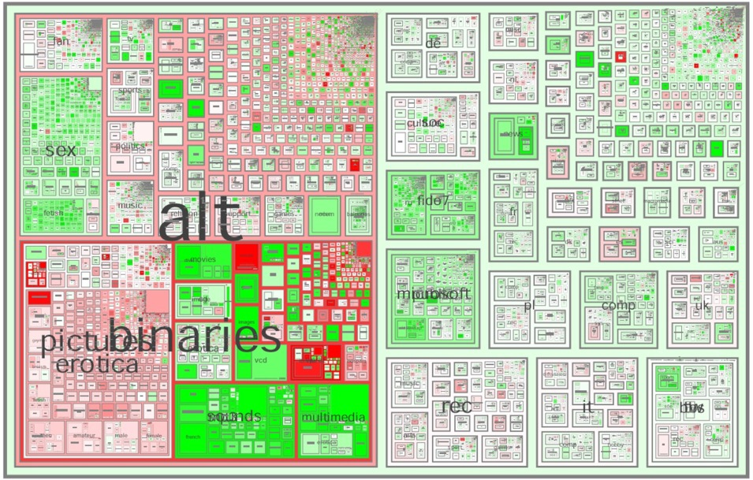
Tree-Map
Screen-filling method which uses a hierarchical partitioning of the screen into regions depending on the attribute values
The x- and y-dimension of the screen are partitioned alternately according to the attribute values (classes)
MSR Netscan Image
‹#›
Ack.: http://www.cs.umd.edu/hcil/treemap-history/all102001.jpg
Notes:
‹#›

Slide 41
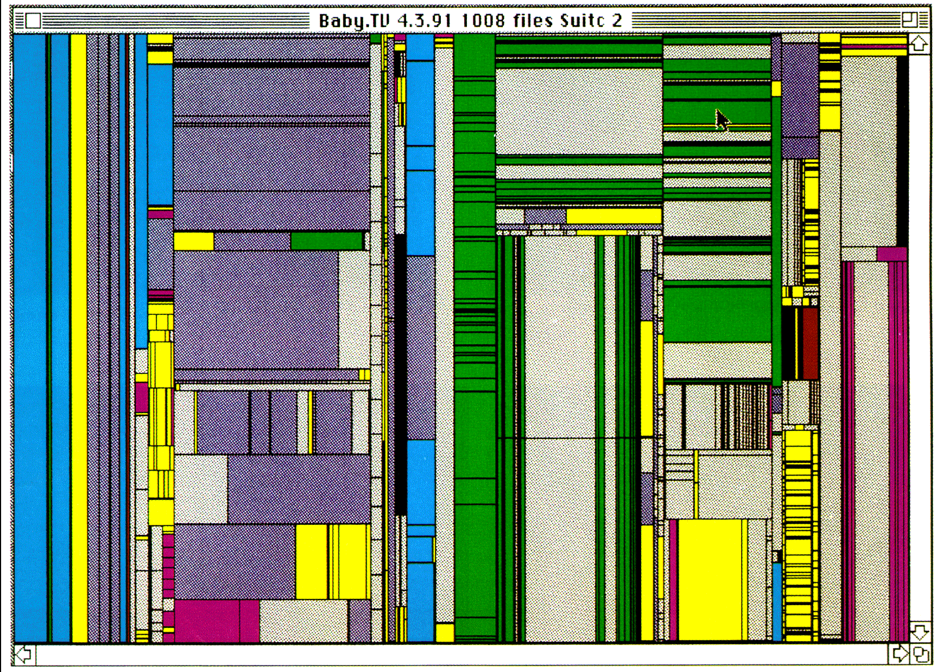
Tree-Map of a File System (Schneiderman)
‹#›
Notes:
‹#›

Slide 42

InfoCube
A 3-D visualization technique where hierarchical information is displayed as nested semi-transparent cubes
The outermost cubes correspond to the top level data, while the subnodes or the lower level data are represented as smaller cubes inside the outermost cubes, and so on
‹#›
Notes:
‹#›

Slide 43
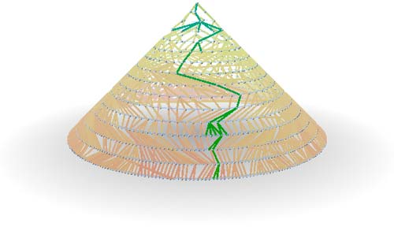
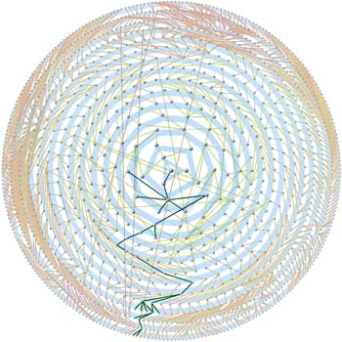
Three-D Cone Trees
3D cone tree visualization technique works well for up to a thousand nodes or so
First build a 2D circle tree that arranges its nodes in concentric circles centered on the root node
Cannot avoid overlaps when projected to 2D
G. Robertson, J. Mackinlay, S. Card. “Cone Trees: Animated 3D Visualizations of Hierarchical Information”, ACM SIGCHI'91
Graph from Nadeau Software Consulting website: Visualize a social network data set that models the way an infection spreads from one person to the next
Ack.: http://nadeausoftware.com/articles/visualization
‹#›
Notes:
‹#›

Slide 44
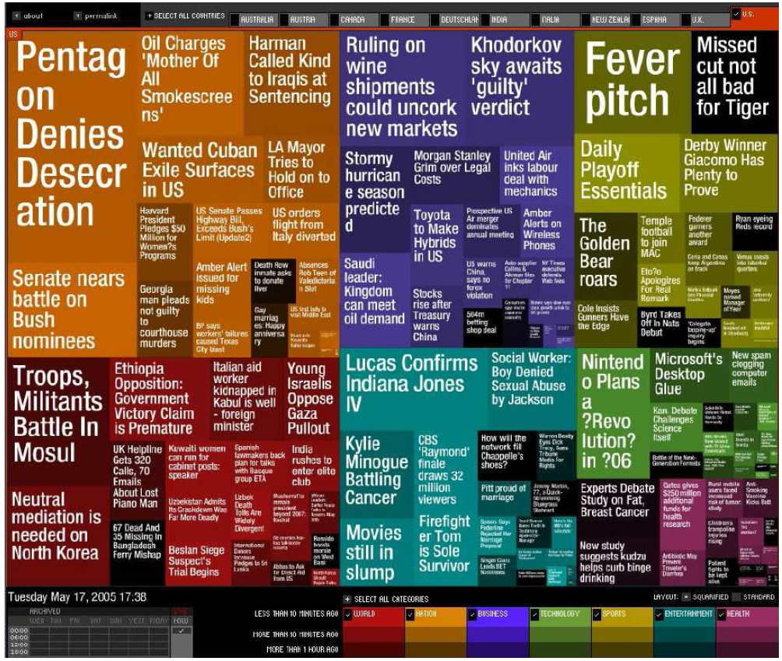
Visualizing Complex Data and Relations
Visualizing non-numerical data: text and social networks
Tag cloud: visualizing user-generated tags
The importance of tag is represented by font size/color
Besides text data, there are also methods to visualize relationships, such as visualizing social networks
Newsmap: Google News Stories in 2005

Slide 45
Similarity and Dissimilarity
Similarity
Numerical measure of how alike two data objects are
Value is higher when objects are more alike
Often falls in the range [0,1]
Dissimilarity (e.g., distance)
Numerical measure of how different two data objects are
Lower when objects are more alike
Minimum dissimilarity is often 0
Upper limit varies
Proximity refers to a similarity or dissimilarity
‹#›
Notes:
‹#›

Slide 46
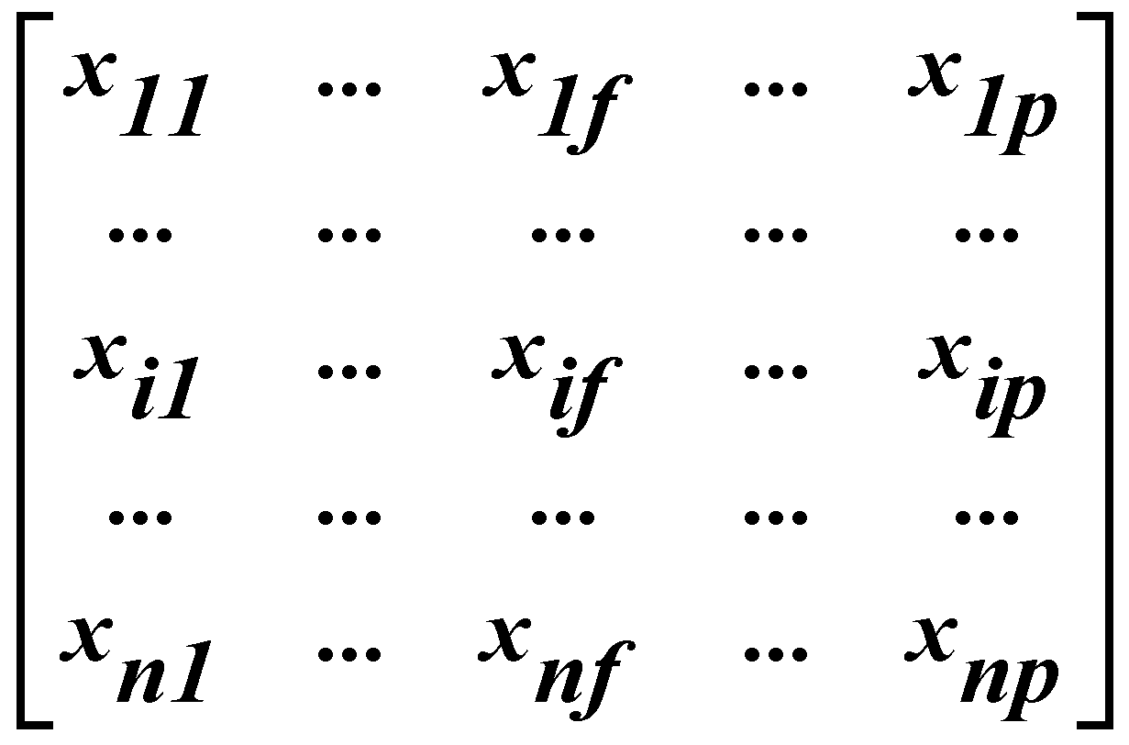
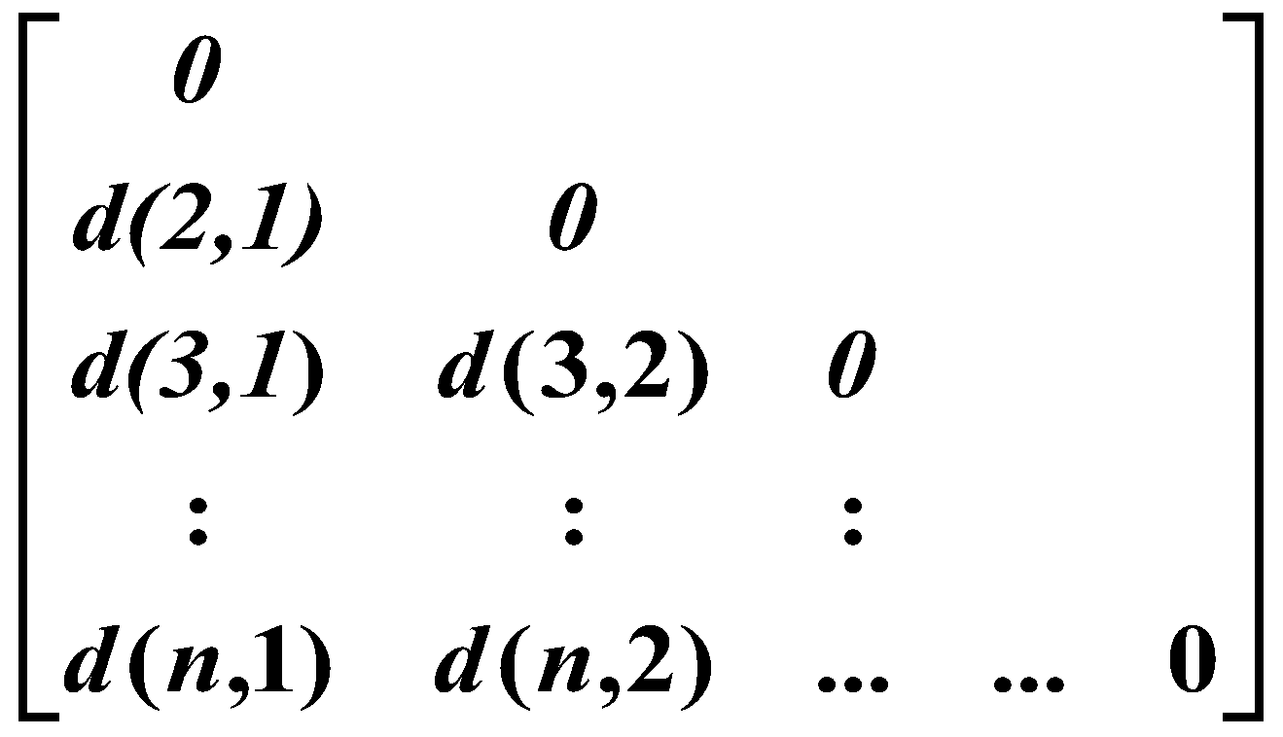
Data Matrix and Dissimilarity Matrix
Data matrix
n data points with p dimensions
Two modes
Dissimilarity matrix
n data points, but registers only the distance
A triangular matrix
Single mode
‹#›
Notes:
‹#›

Slide 47
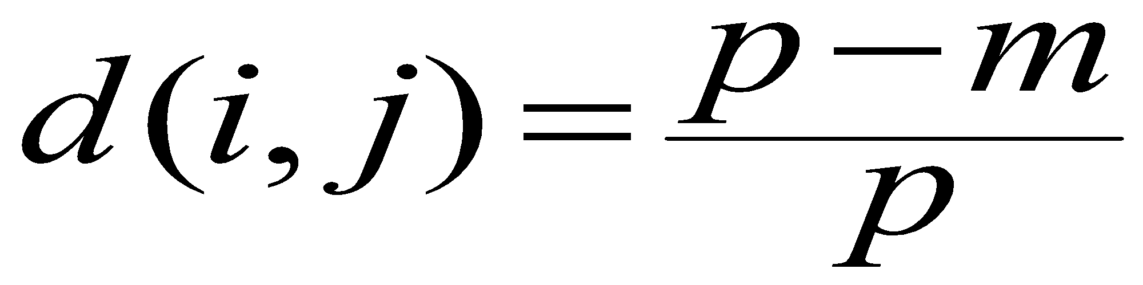
Proximity Measure for Nominal Attributes
Can take 2 or more states, e.g., red, yellow, blue, green (generalization of a binary attribute)
Method 1: Simple matching
m: # of matches, p: total # of variables
Method 2: Use a large number of binary attributes
creating a new binary attribute for each of the M nominal states
‹#›
Notes:
‹#›

Slide 48
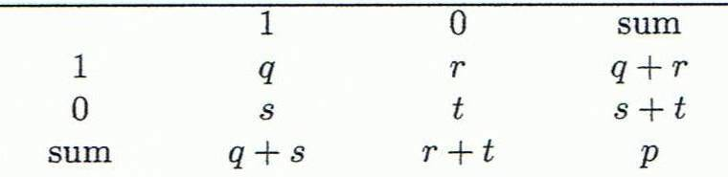



Proximity Measure for Binary Attributes
Object j
A contingency table for binary data
Distance measure for symmetric binary variables:
Distance measure for asymmetric binary variables:
Jaccard coefficient (similarity measure for asymmetric binary variables):
Object i
Note: Jaccard coefficient is the same as “coherence”:
‹#›
Notes:
‹#›

Slide 49


Dissimilarity between Binary Variables
Example
Gender is a symmetric attribute
The remaining attributes are asymmetric binary
Let the values Y and P be 1, and the value N 0
‹#›
Notes:
‹#›

Slide 50



Standardizing Numeric Data
Z-score:
X: raw score to be standardized, μ: mean of the population, σ: standard deviation
the distance between the raw score and the population mean in units of the standard deviation
negative when the raw score is below the mean, “+” when above
An alternative way: Calculate the mean absolute deviation
where
standardized measure (z-score):
Using mean absolute deviation is more robust than using standard deviation
‹#›
Notes:
‹#›

Slide 51



Example: Data Matrix and Dissimilarity Matrix
Data Matrix
Dissimilarity Matrix
(with Euclidean Distance)
‹#›
Notes:
‹#›

Slide 52
Distance on Numeric Data: Minkowski Distance
Minkowski distance: A popular distance measure
where i = (x_{i1}, x_{i2}, …, x_{ip}) and j = (x_{j1}, x_{j2}, …, x_{jp}) are two p-dimensional data objects, and h is the order (the distance so defined is also called L-h norm)
Properties
d(i, j) > 0 if i ≠ j, and d(i, i) = 0 (Positive definiteness)
d(i, j) = d(j, i) (Symmetry)
d(i, j) ≤ d(i, k) + d(k, j) (Triangle Inequality)
A distance that satisfies these properties is a metric
‹#›
Notes:
‹#›

Slide 53



Special Cases of Minkowski Distance
h = 1: Manhattan (city block, L₁ norm) distance
E.g., the Hamming distance: the number of bits that are different between two binary vectors
h = 2: (L₂ norm) Euclidean distance
h → ∞. “supremum” (L_{max} norm, L∞ norm) distance.
This is the maximum difference between any component (attribute) of the vectors
‹#›
Notes:
‹#›

Slide 54




Example: Minkowski Distance
Dissimilarity Matrices
Manhattan (L₁)
Euclidean (L₂)
Supremum
‹#›
Notes:
‹#›

Slide 55


Ordinal Variables
An ordinal variable can be discrete or continuous
Order is important, e.g., rank
Can be treated like interval-scaled
replace x_{if} by their rank
map the range of each variable onto [0, 1] by replacing i-th object in the f-th variable by
compute the dissimilarity using methods for interval-scaled variables
‹#›
Notes:
‹#›

Slide 56


Attributes of Mixed Type
A database may contain all attribute types
Nominal, symmetric binary, asymmetric binary, numeric, ordinal
One may use a weighted formula to combine their effects
f is binary or nominal:
d_{ij}^{(f)} = 0 if x_{if} = x_{jf} , or d_{ij}^{(f)} = 1 otherwise
f is numeric: use the normalized distance
f is ordinal
Compute ranks r_{if} and
Treat z_{if} as interval-scaled
‹#›
Notes:
‹#›

Slide 57

Cosine Similarity
A document can be represented by thousands of attributes, each recording the frequency of a particular word (such as keywords) or phrase in the document.
Other vector objects: gene features in micro-arrays, …
Applications: information retrieval, biologic taxonomy, gene feature mapping, ...
Cosine measure: If d₁ and d₂ are two vectors (e.g., term-frequency vectors), then
cos(d₁, d₂) = (d₁ ∙ d₂) /||d₁|| ||d₂|| ,
where ∙ indicates vector dot product, ||d||: the length of vector d
‹#›
Notes:
‹#›

Slide 58
Example: Cosine Similarity
cos(d₁, d₂) = (d₁ ∙ d₂) /||d₁|| ||d₂|| ,
where ∙ indicates vector dot product, ||d|: the length of vector d
Ex: Find the similarity between documents 1 and 2.
d₁ = (5, 0, 3, 0, 2, 0, 0, 2, 0, 0)
d₂ = (3, 0, 2, 0, 1, 1, 0, 1, 0, 1)
d₁∙d₂ = 5*3+0*0+3*2+0*0+2*1+0*1+0*1+2*1+0*0+0*1 = 25
||d₁||= (5*5+0*0+3*3+0*0+2*2+0*0+0*0+2*2+0*0+0*0)^{0.5}=(42)^{0.5} = 6.481
||d₂||= (3*3+0*0+2*2+0*0+1*1+1*1+0*0+1*1+0*0+1*1)^{0.5}=(17)^{0.5} = 4.12
cos(d₁, d₂ ) = 0.94
‹#›
Notes:
‹#›

Slide 59
Summary
Data attribute types: nominal, binary, ordinal, interval-scaled, ratio-scaled
Many types of data sets, e.g., numerical, text, graph, Web, image.
Gain insight into the data by:
Basic statistical data description: central tendency, dispersion, graphical displays
Data visualization: map data onto graphical primitives
Measure data similarity
Above steps are the beginning of data preprocessing.
Many methods have been developed but still an active area of research.
‹#›
Notes:
‹#›

